Slide 1
When are reminders for behavior modification effective? Experimental evidence from the use of text messages to improve medication adherence
James Habyarimana (Georgetown)
Kiki Pop-Eleches (Columbia)
Duncan Ngare (Moi U)
Harsha Thirumurthy (UNC-Chapel Hill & World Bank)

Slide 2
Context
Growing interest in role of psychological and attitudinal factors in health and economic behaviors
People may not carry out actions that are desirable
  Adherence to medications
  Vaccinating children, follow-up PMTCT care
  Saving money on regular basis
Could derive from psychological, not economic, barriers
Growing cell phone availability makes it easier/cheaper to contact individuals
  Potential for use in healthcare settings (mHealth)

Slide 3
Can reminders be useful?
External events or antecedents to behavior – such as cues/reminders - may be effective in this context
Small literature that explores whether reminders are effective in modifying behavior
  Some applications in health care settings (later)
  Recent evidence that reminders sent by banks (usually via text messages) can encourage savings
  Karlan et al. (2010) find that these reminders do lead to higher savings

Slide 4
Evidence gap on benefits of SMS
Lack of rigorous evidence of efficacy of SMS and usefulness for promoting good outcomes
Operational issues
  Know little about optimal content and timing of reminders
  Other uses of SMS, such as providing motivation
Frequency & source of messages may be important
  One-time information provision is usually considered adequate, but do people need to be reminded regularly?
  Do reminders lead to habit formation?
  Do people “tune out” repeated reminders?

Slide 5
Outline
Adherence to ART
  Defining incomplete adherence and challenge of measuring it
  Barriers and facilitators; appropriate interventions
Chulaimbo Adherence and Phone Study (CAPS)
  Study site and design
  SMS intervention and randomization
  Enrollment and follow-up procedures
  Results
Conclusions/discussion

Slide 6
Adherence to ART
Success of ART hinges on long-term adherence
Usually defined as actual/prescribed doses
  Alternative definitions: lack of prolonged interruptions, adherence exceeding 90 percent
Problems associated with incomplete adherence
  Differing half-life of ARVs can lead to monotherapy
  Failure to suppress virus (higher viral load)
  Failure to prevent disease progression and death
  Development of drug resistance

Slide 7
Challenge of measuring adherence
Most common strategy is to interview patients about recent missed doses
  Subject to social desirability bias
Pill counts in clinic or unannounced pill counts at home
Electronic monitoring (MEMS caps)
  Precise and objective but not feasible in routine clinical care
  Not widely used in developing countries
Systematic review by Mills et al. (JAMA, 2006)
  Higher adherence levels in Africa than North America (but regimens often more complicated in US)
  MEMS adherence significantly lower (19 percent)

Slide 8
Barriers and facilitators to adherence
Mills et al. (PLoS Med, 2006) systematic review of qualitative and quantitative studies
Barriers
  Fear of disclosure
  Concomitant substance abuse
  Forgetfulness
  Regimens too complicated, number of pills required
  Decreased quality of life
  Work and family responsibilities
  Social isolation
Facilitators
  Having sense of self-worth
  Seeing positive effects of ARVs
  Accepting own HIV status
  Understanding need for strict adherence
  Making use of reminder tools
  Having a simple regimen

Slide 9
Early stages of mHealth in LICs
Ongoing studies for TB & ART adherence (South Africa)
Proof of concept in Kenya (Lester AIDS 2006)
  MCH and CSW clinics: 53% able to read & write SMS
  54% indicated comfort with receiving HIV information by phone
  Confidentiality issues likely to be of utmost importance
RCT evidence: WelTel Kenya1 trial (Lancet 2010)

Slide 10
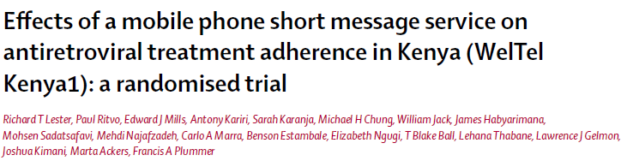
WelTel Kenya1 trial (Lancet 2010) – Nairobi
  538 participants randomized to intervention or standard care
  Intervention group received weekly SMS messages and were required to respond within 48 hours
  Intervention group received weekly message (“Mambo?”) and was asked to respond within 48 hours (“Sawa” or “Shida”)
  Clinician called non-responders and those who indicated problem

Slide 11
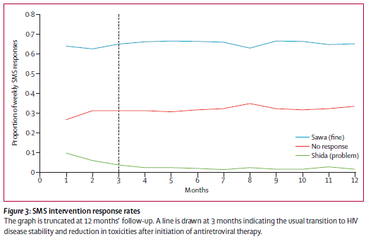
Do patients respond to SMS?

Slide 12
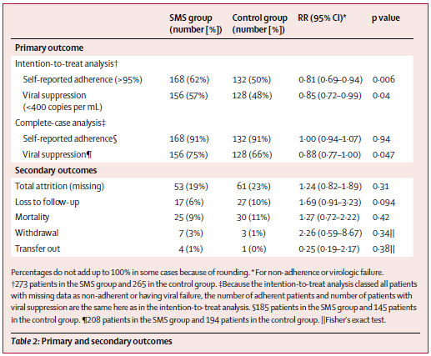
Main results (WelTel Kenya1)
Better self-reported adherence and lower viral loads among intervention group

Slide 13
Lester et al: issues to consider
Limited to ART patients with phones
ART adherence measure is self-reported
Intervention requires greater attention from clinic staff

Slide 14
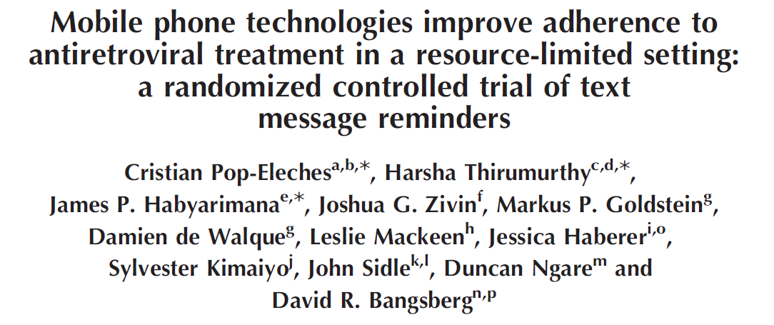
AIDS 2011 Mar 27;25(6):825-834

Slide 15

Chulaimbo Adherence & Phone Study (CAPS)
Implemented at rural health center in Nyanza Province
2007 HIV prevalence highest in Kenya (15%)
Chulaimbo Rural Health Center
  Gov’t-run rural facility
  Hosts an HIV clinic managed by AMPATH
Approved by ethics committees at Moi University, UNC, and Georgetown

Slide 16
Study design
Eligibility criteria
  HIV-positive men & women initiating ART within previous 3 mths
  Agree to use electronic bottle caps & potentially receive text messages
  Phone ownership not necessary (provided by study)
Enrollment from June 2007-July 2008
  Conducted on a rolling basis
  Patients given phone, monthly charging credit ($1.50), $1 phone credit every 2 months to keep SIM card active
  720 patients enrolled by July 2008
    15 declined to participate

Slide 17
SMS intervention and randomization
Participants randomly assigned to one of five groups
  1 control group that received no text messages
  4 treatment groups that received automated messages
    Daily, short message
    Weekly, short message
    Daily, long message
    Weekly, long message
Message content
  Developed in consultation with AMPATH staff, pre-tested
  Sent in language chosen by respondent (Luo, Swahili, or English)
  Short message: “Hello, this is your daily/weekly reminder”
  Long message: “Hello, this is your reminder. Be strong and courageous”

Slide 18
Sample sizes
Analysis sample: 431 patients enrolled by Jan. 31, 2008
  Sample for which 48-week follow-up potentially available
66.6 percent of participants randomly assigned to one of the four treatment groups, 33.3 percent to control group
Distribution of 431 participants
  139 in control group
  70-74 in each of the four treatment groups

Slide 19
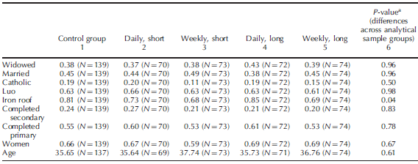
Baseline characteristics

Slide 20
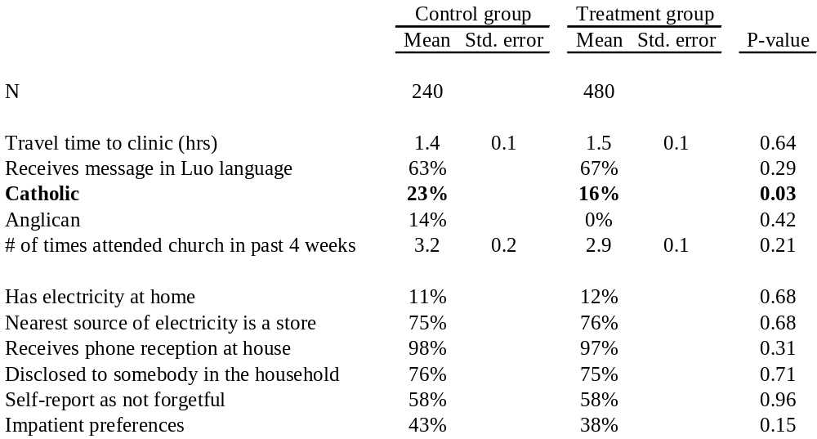
Additional baseline characteristics (full sample)

Slide 21
Measuring adherence
Patients given one of 3 ARVs in bottle with MEMS cap
  Typical medication was efavirenz
  Medication refills had to be obtained by patients every month at clinic
MEMS cap scanned at pharmacy during each clinic visit
  If patient misses appointment, no scan conducted
  Brief return visit questionnaire also completed

Slide 22
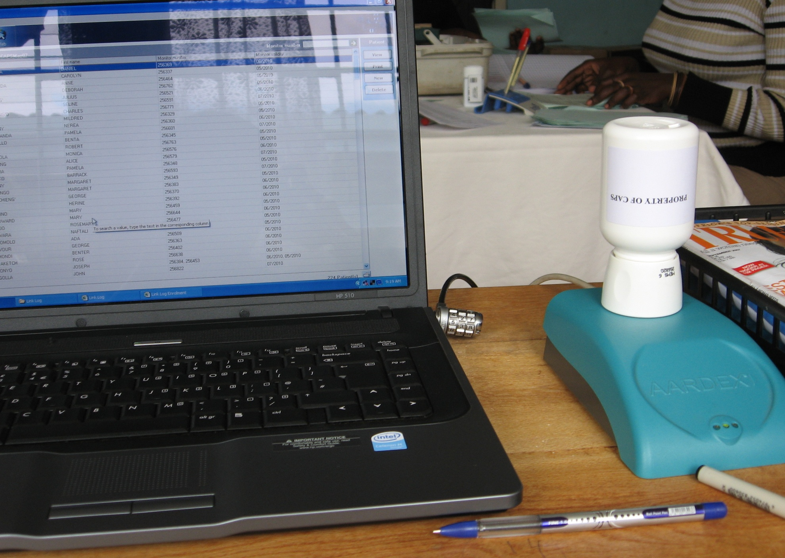

Slide 23
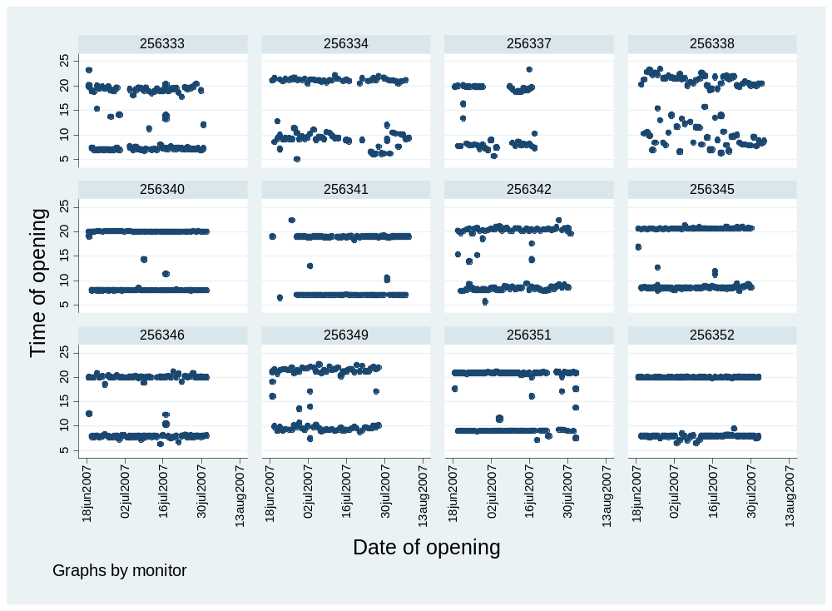

Slide 24
Adherence outcomes
Overall adherence rate: percentage of prescribed doses taken
  Prescribed doses = 2 times per day
  Truncation in cases of >2 openings per day
Indicator for overall adherence ≥90 percent
Occurrence treatment interruptions exceeding 48 hours

Slide 25
Analysis
Analysis performed at patient-level
Periods of analysis: Quarters 1-4 and 48-weeks
Intent-to-treat (ITT) analysis, with those lost-to-follow-up considered to have imperfect adherence
Per-protocol (PP) analysis, with those lost-to-follow-up dropped from sample for each quarter

Slide 26
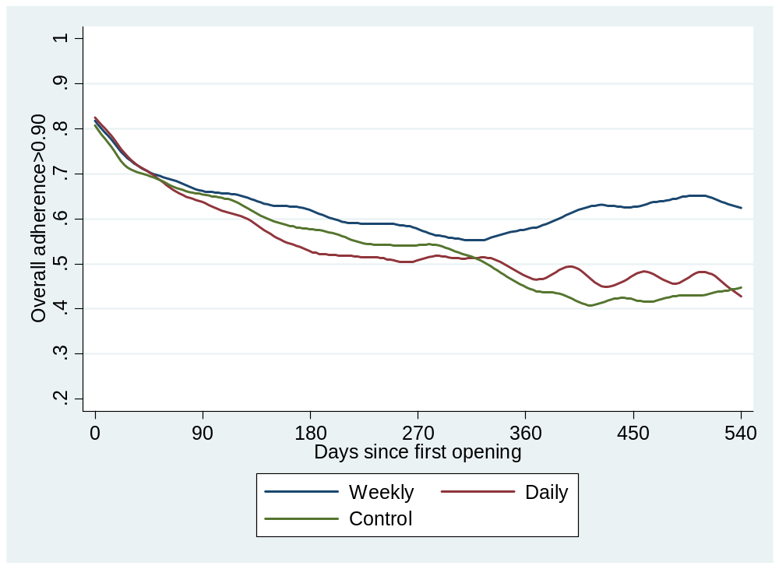
Adherence above 90%

Slide 27
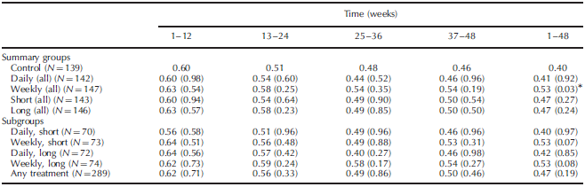
ITT: effects on adherence ≥90%
Weekly messages most effective

Slide 28
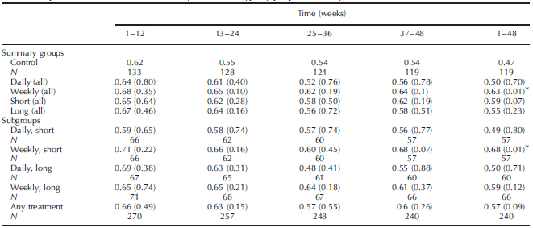
PP: effects on adherence ≥90%

Slide 29
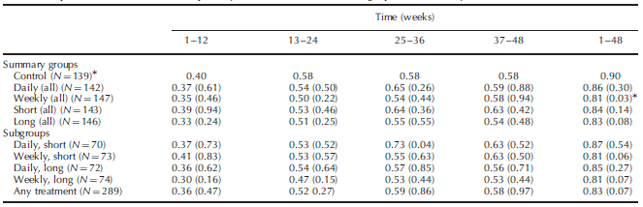
ITT: effects on interruptions ≥48 hrs
Weekly messages most effective in reducing occurrence of treatment interruptions

Slide 30
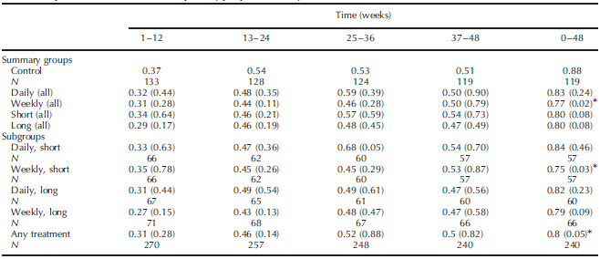
PP: effects on interruptions ≥48 hrs

Slide 31
Conclusions
Weekly reminders improved adherence significantly, daily reminders did not
  Effects stems from prevention of decline in adherence
Habituation, or diminishing response to a frequently repeated stimulus, may explain main finding
Adding words of encouragement not more effective than simple, short reminders
  Format and content of reminders are important
Potential for wide-scale use to improve adherence given the low cost of delivering SMS

Slide 32
Limitations
Cannot positively distinguish whether intervention improved dose taking behavior or simply improved use of MEMS cap
Present results do not show effects on CD4 counts and viral loads
Generalizability of results hinges of additional, larger-scale evaluations of reminders
Two-way SMS may increase adherence impacts

Slide 33
Acknowledgements
AMPATH
Chulaimbo RHTC
Financial support
  The World Bank
  USAID-AMPATH Partnership
Project staff
  Leslie Mackeen
  Eunice Were
Collaborators
  Cristian Pop-Eleches
  James Habyarimana
  Joshua Graff Zivin
  Markus Goldstein
  Damien de Walque
  Jessica Haberer
  Duncan Ngare
  John Sidle
  Sylvester Kimaiyo
  David Bangsberg

